Slide 1
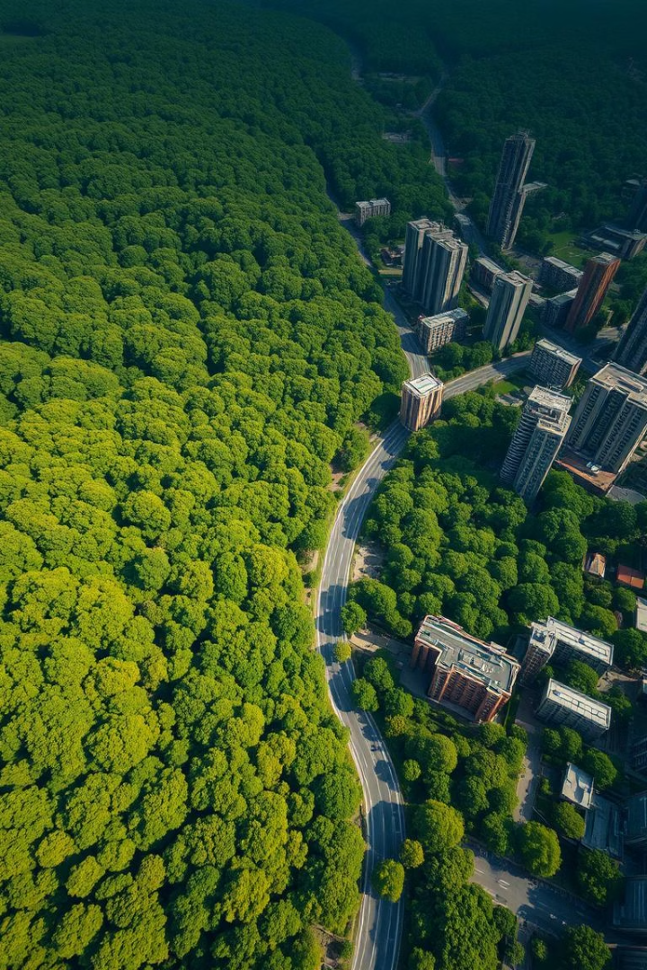
Automated Green Zone Analysis Using Computer Vision
Advanced Vegetation Detection in Aerial Images
by An Quang Nguyen

Slide 2

Problem Statement: The Challenge of Manual Analysis
Manual Analysis Issues
Solution Required
Time-consuming
Automated, accurate, and scalable vegetation analysis is essential for modern urban planning and environmental monitoring.
Subjective results
Inefficient for large areas
Inconsistent data
Limited scalability

Slide 3
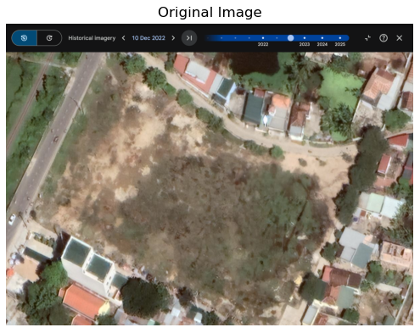


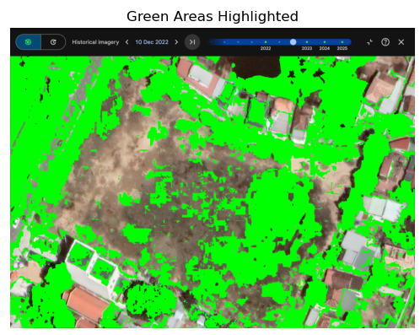


Project Overview: Automated Vegetation Coverage
Automated System
Calculate vegetation coverage percentage
Key Features
Batch processing, multi-algorithm, varied lighting
Flexible Exports
CSV, JSON, TXT outputs
Real-time View
Visualize detection results instantly

Slide 4
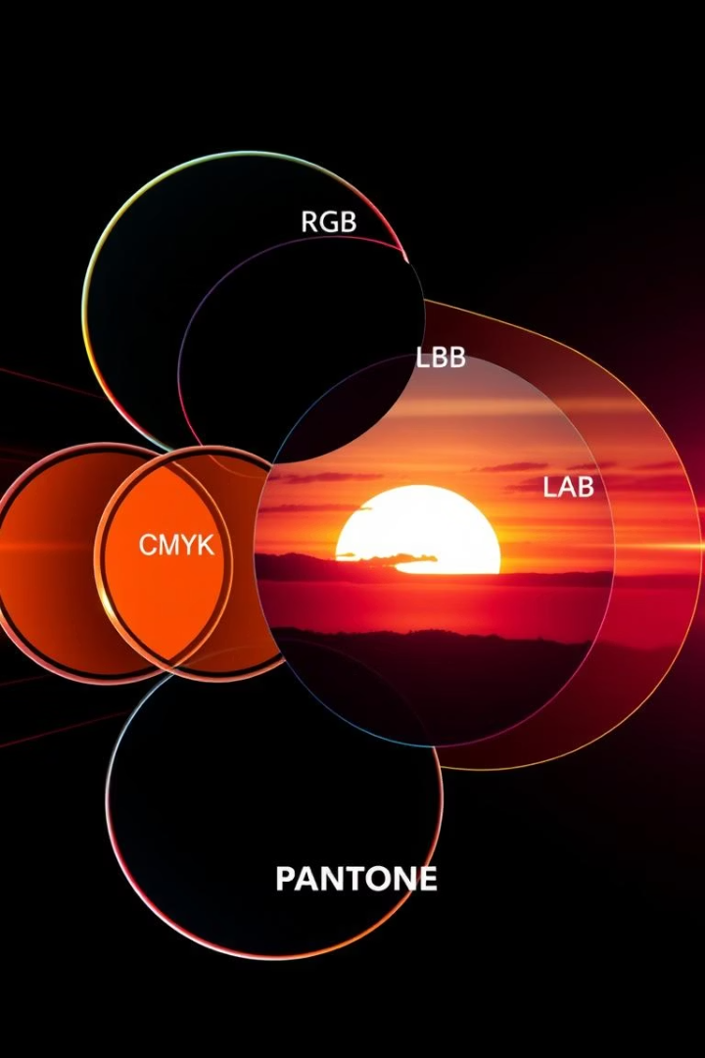
Technical Approach: Multi-Method Detection
Color Space Analysis
HSV for superior color separation.
Dominance & Hue
RGB Green and Yellow-Green detection.
Adaptive Processing
Adaptive Thresholding and Vegetation Index.
Refinement
Morphological Operations for noise reduction.

Slide 5

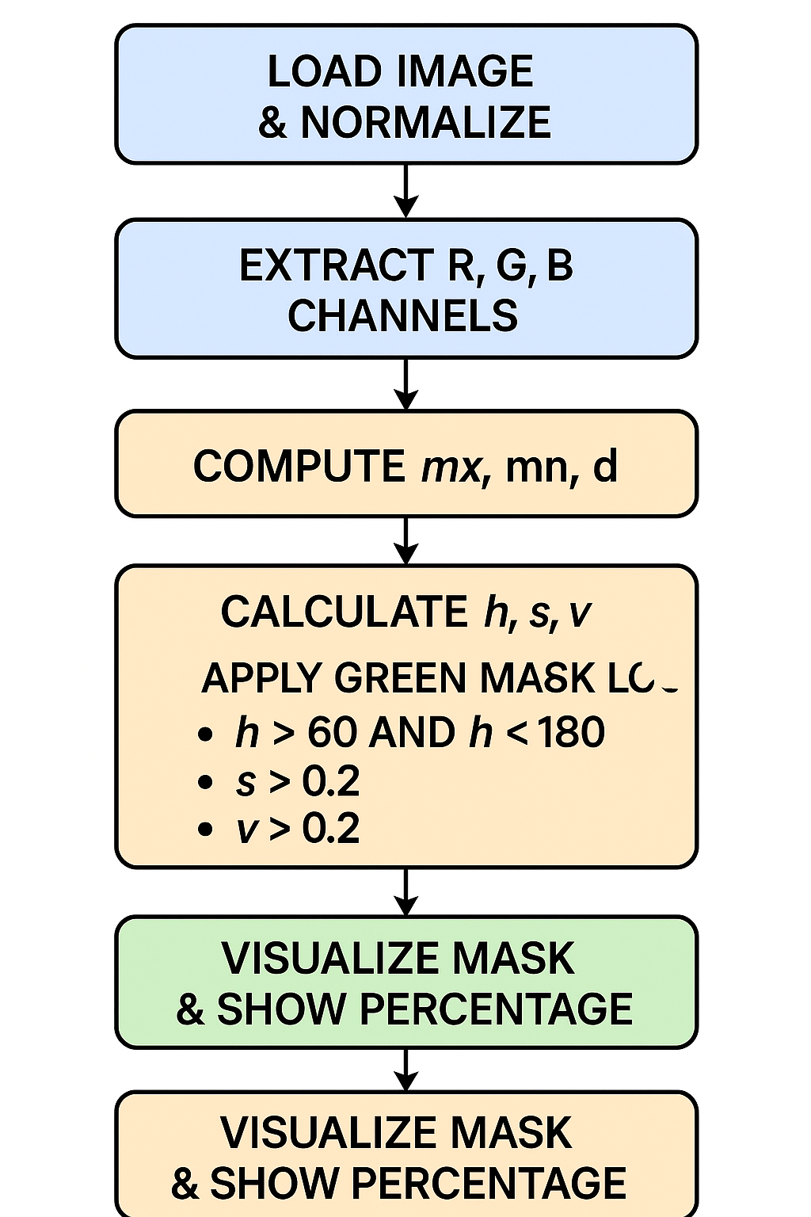






Algorithm Workflow: Step-by-Step Processing
Image Input
Load aerial images
Color Conversion
RGB to HSV transformation
Multi-Algorithm Detection
Apply all 7 methods
Mask Combination
Combine results via OR logic
Post-Processing
Noise reduction, smoothing
Percentage Calculation
Green pixels vs. total
Visualization
Generate analysis charts

Slide 6
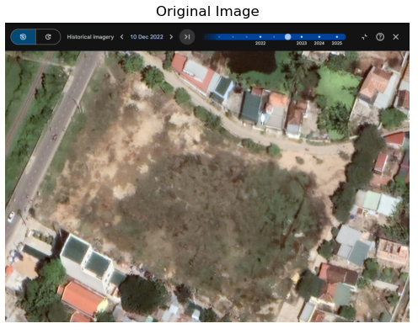
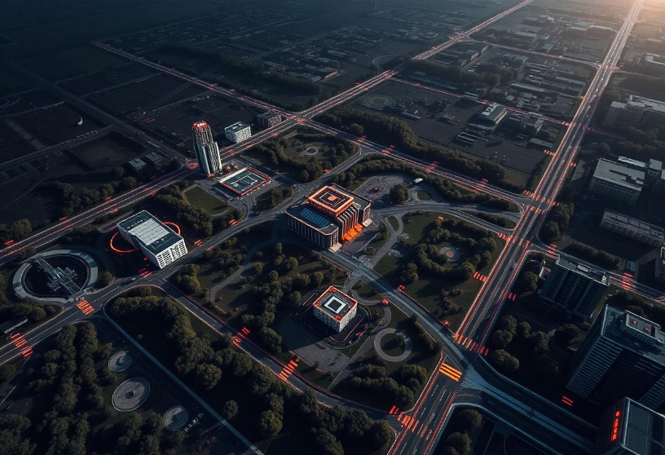
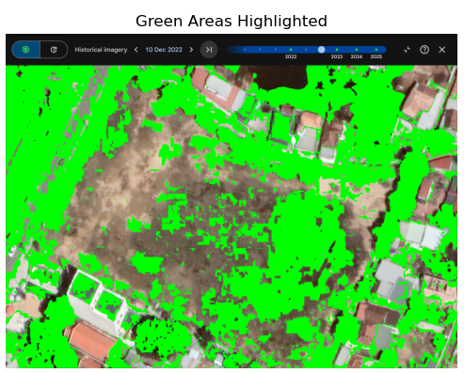
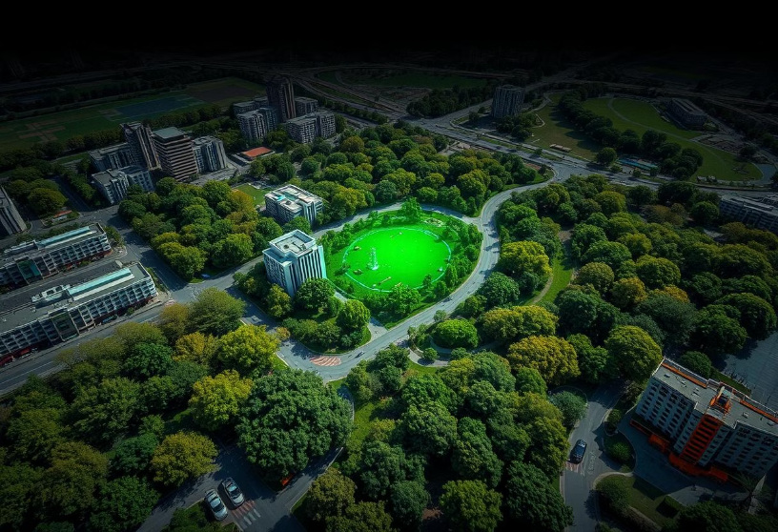
Before & After Comparison: Visualizing Impact
Original Image
Detection Results
Enhanced algorithm detected 15.8% vegetation versus 4.2% with basic RGB, successfully identifying light and seasonal vegetation while reducing false positives.

Slide 7




Technical Implementation: Powering the Analysis
Python
Core programming language
PIL/NumPy
Image processing and numerical computations
Matplotlib/SciPy
Visualization and advanced operations
Key algorithms include HSV conversion, multi-threshold segmentation, morphological processing, and statistical reporting for robust analysis.

Slide 8
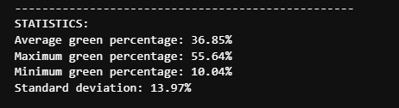
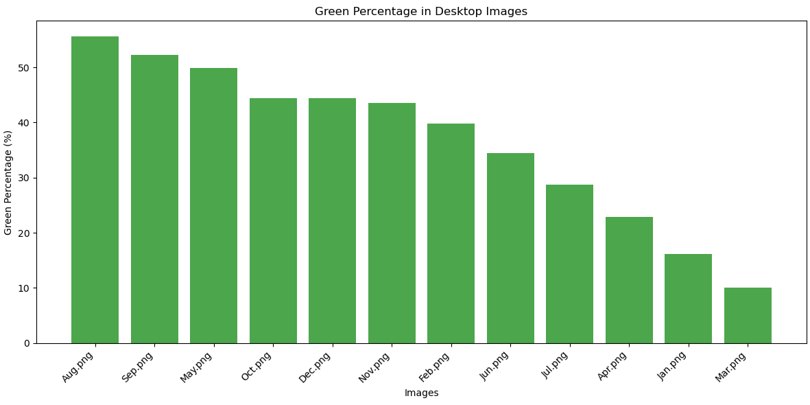
Results & Performance: Accuracy and Speed
90%
5s
Accuracy
Processing
Enhanced Algorithm
Per Image
50+
Batch
Images/Run
My enhanced algorithm boasts significantly improved accuracy over traditional methods, efficiently handling diverse vegetation types and lighting conditions.

Slide 9








Real-World Applications: Impact Across Sectors
Urban Planning
Environmental Monitoring
Green space monitoring
Deforestation tracking
Environmental assessments
Ecosystem health
Smart city development
Climate change studies
Agriculture
Research & Development
Crop coverage analysis
Environmental datasets
Land use optimization
Academic studies
Precision farming

